Slide 1
Analysis of Algorithms

Slide 2

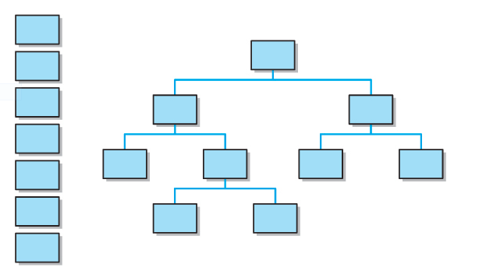
Why need to learn Data Structure & Algorithms

Slide 3
Why need to learn Data Structure?
arrays
linked lists
stacks
queues
trees
Sets and Maps
hash-tables

Slide 4
Scope
Efficiency goals
The concept of algorithm analysis
Big-Oh notation
The concept of asymptotic complexity
Comparing various growth functions

Slide 5
Algorithm Efficiency
The efficiency of an algorithm is usually expressed in terms of its use of CPU time
The analysis of algorithms involves categorizing an algorithm in terms of efficiency
An everyday example: washing dishes
Suppose washing a dish takes 30 seconds and drying a dish takes an additional 30 seconds
Therefore, n dishes require n minutes to wash and dry

Slide 6
Algorithm Efficiency
Now consider a less efficient approach that requires us to re-dry all previously washed dishes after washing another one

Slide 7
import java.util.Scanner;
public class WasherDryer {
public static void main(String[] args) {
long number;
Scanner input = new Scanner(System.in);
System.out.println("Enter the number of dishes that you want to wash:");
number = input.nextLong();
long startTimeFirst = System.nanoTime();
niceWash(number);
long endTimeFirst = System.nanoTime();
long totalTimeFirst = endTimeFirst - startTimeFirst;
System.out.println("CPU Time to complete of nice wash is: " + totalTimeFirst +" nanoseconds");
long startTimeSecond = System.nanoTime();

Slide 8
badWash(number);
long endTimeSecond = System.nanoTime();
long totalTimeSecond = endTimeSecond - startTimeSecond;
System.out.println("CPU Time to complete of bad wash is: " + totalTimeSecond + " nanoseconds");
}//close main
public static void niceWash(long n){//O(1)
System.out.println(n +" dishes to wash it would take nice wash/dry: " + n*60 +" seconds");
}
public static void badWash(long n){ //0(n²)
double timing=15 *Math.pow(n,2)+ n*45;
System.out.println("\n\n"+ n +" dishes to wash it would take sloppy wash/dry: " + timing +" seconds");
}
}

Slide 9
Problem Size
For every algorithm we want to analyze, we need to define the size of the problem
The dishwashing problem has a size n – number of dishes to be washed/dried
For a search algorithm, the size of the problem is the size of the search pool
For a sorting algorithm, the size of the program is the number of elements to be sorted

Slide 10
Growth Functions
We must also decide what we are trying to efficiently optimize
time complexity – CPU time
space complexity – memory space
CPU time is generally the focus
A growth function shows the relationship between the size of the problem (n) and the value optimized (time)

Slide 11
Asymptotic Complexity
The growth function of the second dishwashing algorithm is
t(n) = 15n² + 45n
It is not typically necessary to know the exact growth function for an algorithm
We are mainly interested in the asymptotic complexity of an algorithm – the general nature of the algorithm as n increases

Slide 12
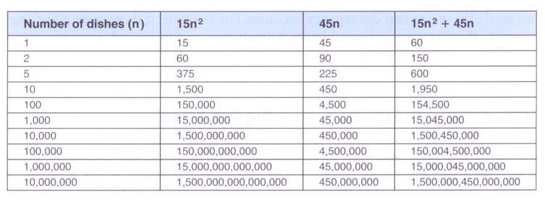
Asymptotic Complexity
Asymptotic complexity is based on the dominant term of the growth function – the term that increases most quickly as n increases
The dominant term for the second dishwashing algorithm is n²:

Slide 13
public class DominantTermTester {
public static void main(String[] args) {
int n;
double time;
Scanner keyboard=new Scanner (System.in);
System.out.println("Input the exponent number of n like 8:");
n = keyboard.nextInt();
time = Math.pow(2, n) + 18 * Math.pow(n, 2) + 3 * n;
System.out.println("Time of growth function " + time);
time = Math.pow(2, n);
System.out.println("Time of dominant term " + time);
System.out.println("Input the a really larger exponent number of n like 800:");
n = keyboard.nextInt();

Slide 14
time = Math.pow(2, n) + 18 * Math.pow(n, 2) + 3 * n;
System.out.println("Time of growth function " + time);
time = Math.pow(2, n);
System.out.println("Time of dominant term " + time);
}
}

Slide 15
Big-Oh Notation
The coefficients and the lower order terms become increasingly less relevant as n increases
So we say that the algorithm is order n², which is written O(n²)
This is called Big-Oh notation
There are various Big-Oh categories
Two algorithms in the same category (
t(n) = 15n² + 45n
F(n) = 150n² + 90n+900)
are generally considered to have the same efficiency, but that doesn't mean they have equal growth functions or behave exactly the same for all values of n

Slide 16
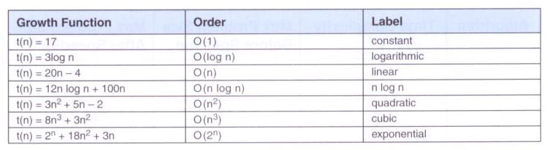
Big-Oh Categories
Some sample growth functions and their Big-Oh categories:

Slide 17
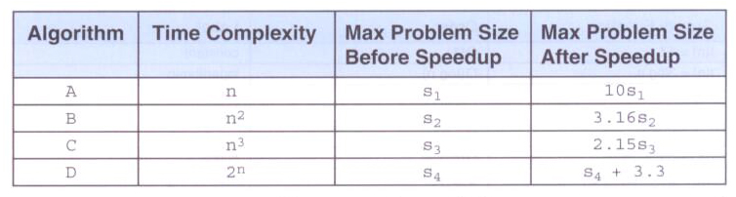
Comparing Growth Functions
You might think that faster processors would make efficient algorithms less important
A faster CPU helps, but not relative to the dominant term. If an algorithm is inefficient, speeding up the processor will not help!!

Slide 18
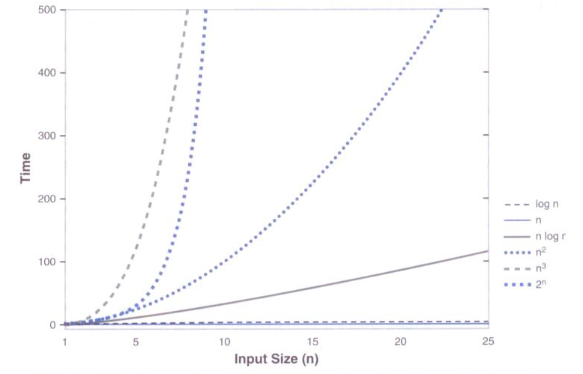
Comparing Growth Functions
As n increases, the various growth functions diverge dramatically:

Slide 19
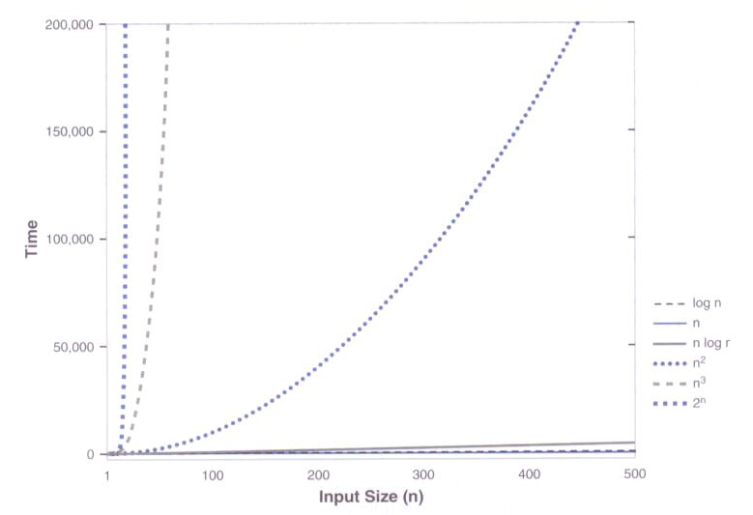
Comparing Growth Functions
For large values of n, the difference is even more pronounced:

Slide 20
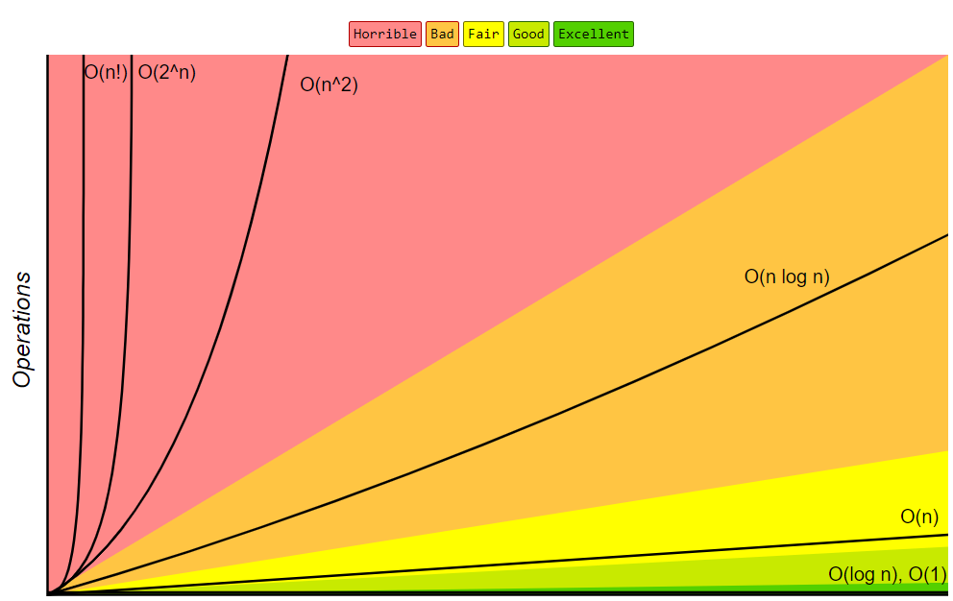

Slide 21
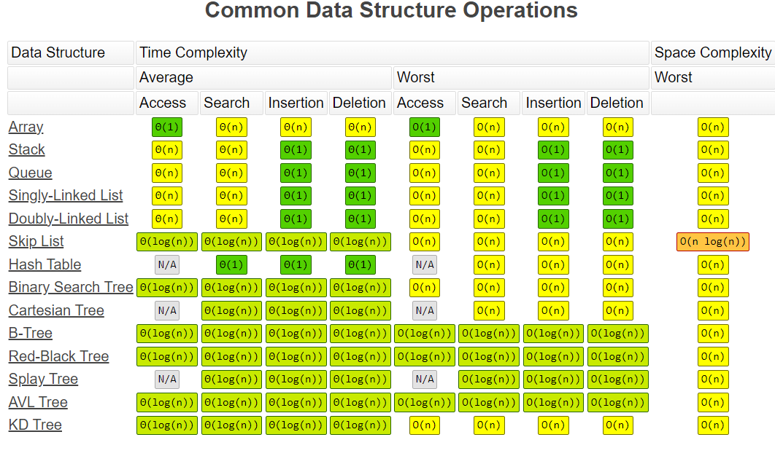
Notes:
Stack: LILO
Queue: FIFO

Slide 22
Analyzing Loop Execution
First determine the order of the body of the loop, then multiply that by the number of times the loop will execute
for (int count = 0; count < n; count++)
// some sequence of O(1) steps
N loop executions times O(1) operations results in a O(n) efficiency

Slide 23
Analyzing Loop Execution
Consider the following loop:
count = 1;
while (count < n)
{
count *= 2;
// some sequence of O(1) steps
}
The loop is executed log₂n times, so the loop is O(log₂ n)

Slide 24
Analyzing Nested Loops
When loops are nested, we multiply the complexity of the outer loop by the complexity of the inner loop
for (int count = 0; count < n; count++)
for (int count2 = 0; count2 < n; count2++)
{
// some sequence of O(1) steps
}
Both the inner and outer loops have complexity of O(n)
The overall efficiency is O(n²)

Slide 25
Analyzing Method Calls
The body of a loop may contain a call to a method
To determine the order of the loop body, the order of the method must be taken into account:
for (int count = 0; count < n; count++) // O(n)
{
printsum(count);
}
public void printsum(int count)// O(n)
{
int sum = 0;
for (int i = 1; i < count; i++)
{ sum += i;}
}
O(n²) using this implementation of the printSum method

Slide 26
Analyzing Method Calls
for (int count = 0; count < n; count++) // O(n)
{
printsum(count);
}
public void printsum(int count)// O(1)
{
int sum=count * (count +1)/2;
}
O(n) using this implementation of the printSum method. We see that there is a difference between only delivering correct result and doing so efficiently.

Slide 27
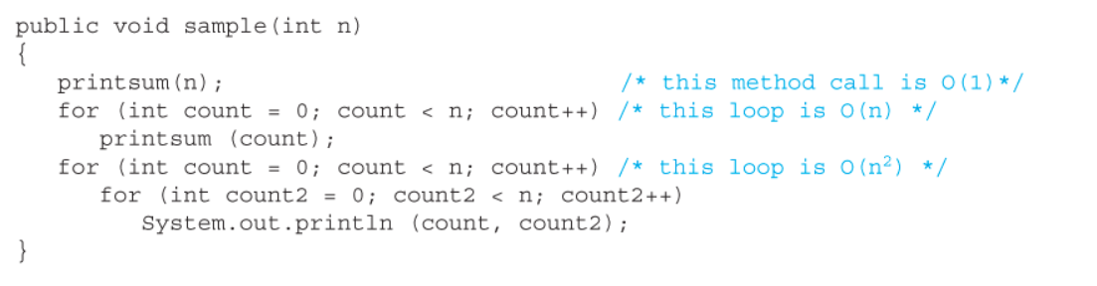
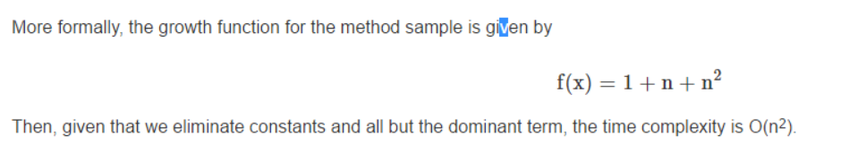
What if the body of a method is made up of multiple method calls and loops? Consider the following code using our printsum method above:

Slide 28
What is the runtime of the below code?
void foo(int[] array) {
int sum = 0;
int product = 1;
for (inti= 0; i < array.length; i++) {
sum += array[i);}
for (int i= 0; i < array.length; i++) {
product*= array[i];}
System.out.println(sum + ", " + product);}

Slide 29
What is the runtime of the below code?
void printPairs(int[] array) {
for (int i= 0; i < array.length; i++) {
for (int j = 0; j < array.length; j++) {
System.out.println(array[i] + "," + array[j]);}
}
}

Slide 30
1. What is the order of the following growth function?
t(n)= 5nlogn + 20n - 4
A. O(1) B. O(log ^{n}) C. O(n) D. O(n log ^{n})
2. The following code segment has ______ time complexity?
for(int i = 0; i < n; i++){
for(int j = 0; j < n; j=j*2){
int val = (j*i);
System.out.println(val)
}
}
A. O(1) B. O(n) C. O(nlog^{n}) D. O(n²)
3. Which Growth function has the highest order?
A. O(n log n) B. O(2^{n}) C. O(n²) D. O(log n)
Notes:
D?????
C????????????
B???????

Slide 31
4. What is the time complexity of the following loop?
for (int count = 0; count = <n; count ++)
{
for (int count2 = 0; count2 < n; count2++)
{
}
}
A. O(n²) B. O(n³) C. O(n) D. O(2^{n})
5. Which of the following has the smallest time complexity?
3n+5+2^{n}
log^{n} + 2
3n+4
n log^{n}
Notes:
4. A
5. b

Slide 32
6. Software must make efficient use of resources such as _______ and ______ .
Hard Drive, Video Card
CPU time, Memory
CPU time, Video Card
Memory, Hard Drive
7. If the algorithm is inefficient, a faster processor will help.
A. True B. False C. None of correct
D. Processor is much faster than before
8. The analysis of nested loops must take into account both the_____
A. if and for statement.
B. <inner and outer Loops>.
C. i++ and j++ incrased
D. CPU and RAM takes
Notes:
6. B
7.

Slide 33
9. Determine the growth function and order of the following code fragment:
for (int count = 0; count < n; count ++)
{
for (int count2 = 0; count2 < n; count2 = count2 * 2)
{
System.out.println(count, count2);
}
}
A. n logo(^{n}). B. O(n log^{n}) C. O(n+n) D. O(n²)
10. The order of an algorithm refers to the __________of the algorithm’s growth function.
A. <How many loops> B. <asymptotic complexity>
C. <How control variables grows> D. <software efficient>
Notes:
9.

